Slide 1
The Future of Dynamic Pricing, Responsive Demand, and Demand Response
Greg Poulos
Executive Director,
Consumer Advocates of the PJM States, Inc.

Slide 2
PJM’s DR Whitepaper
Consumer response to price is essential to efficient and competitive market outcomes, a principle that holds as true for wholesale electricity markets as any other markets. The more that demand actively participates in electricity markets, the more competitive and robust the market results. Additionally, demand response (DR), if visible and dependable, has proven to be a valuable operational tool that assists in maintaining reliability both for real-time grid stability and long-term resource adequacy.
*PJM’s Demand Response Strategy Whitepaper, June 28, 2017, Executive Summary (emphasis added)

Slide 3
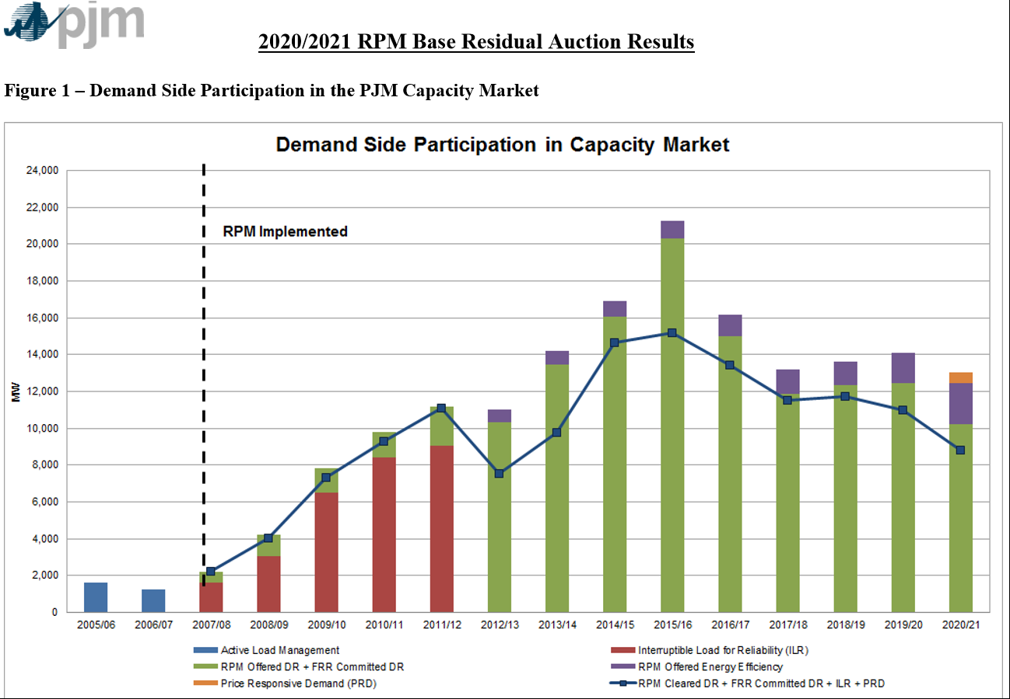

Slide 4
Barriers
PJM Forecasting methodology creates a barrier
Is DR a (high) priority for PJM?
PJM has proposed new barriers to the PRD opportunity
PJM is a summer peaking region that does not value AC resources
Typical retail market realities create inherit barriers
Many utilities have perverse incentives for DR
Utilities are not focused on DR
Electric prices are low!
Customers do not have the right incentives to participate
(My) Conclusion – This is not a customer problem this is an industry/RTO problem….

Slide 5
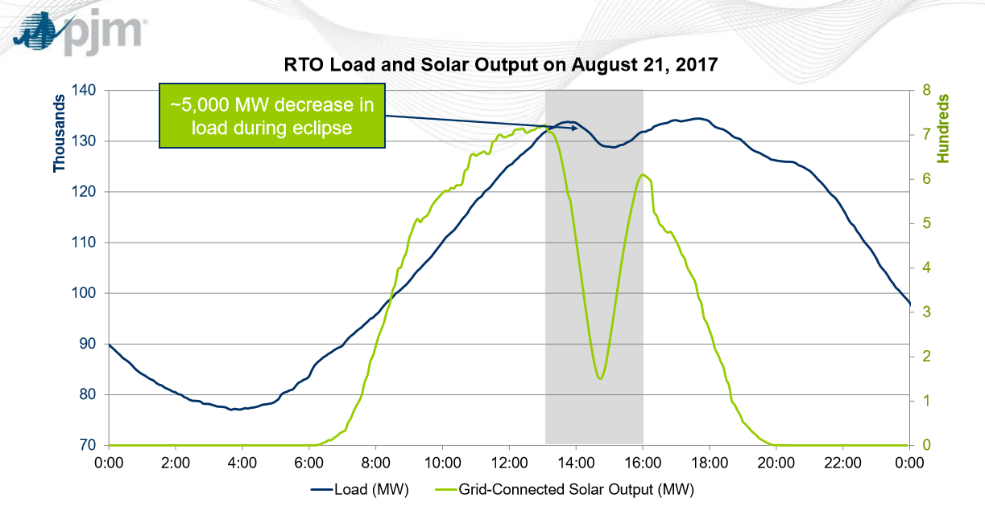
An unexpected result from an expected event

Slide 6
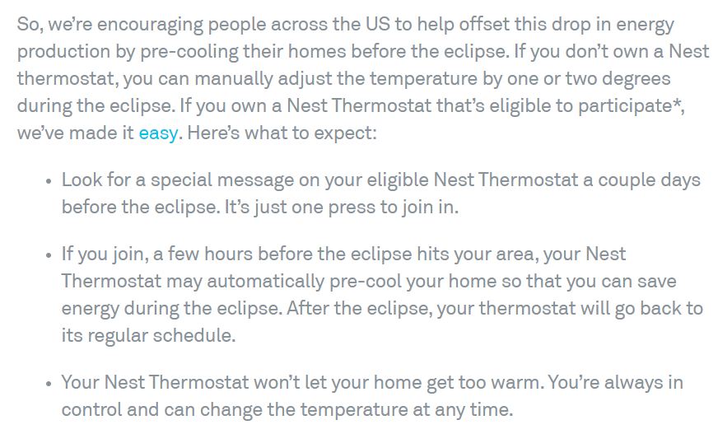
Customer behavior may drive changes

Slide 7
Next Steps?

